Slide 1
Project 1
Title: Blackjack
Course: CIS-5
Section: 41595
Date: February 5, 2023
Author: Vincent Phan

Slide 2
Table of Contents
Introduction
Pseudo Code
Flowchart
Game Play and Rules
Development Summary
Specifications
References
Program Listing

Slide 3
1. Introduction
Blackjack is the most widely-played casino banking game in the world. These types of games for gambling are generally considered a less-skilled card game where one or more players play against a banker who controls the game. The game of blackjack uses 52-card decks, typically with 2-7 players. Furthermore, players do not compete against one another; blackjack is a comparing card game in which each player individually competes against the dealer.
The objective is to win money by creating card totals higher than the dealer’s while not exceeding 21. A player may also win by stopping at a total close to 21 in hope that the dealer will “bust,” or exceed 21 when trying to beat the player. On their turn, players can “hit” (take an additional card), “stand” (end their turn without taking a card), “double” (double their wager and taking a single card, ending their turn), “split” (if the two initial cards have the same value, split them to create two separate hands), or “surrender” (give up half their bet and end their participation in the round).
Number cards are counted as their number. Jacks, queens, and kings (“face cards”) are each counted as 10. Aces are counted as either 1 or 11, depending on the player’s choice. Players bust and immediately lose their bet when their total exceeds 21. After all players are finished, the dealer’s hand is drawn until their total is at least 17. The dealer cannot double, split, nor surrender. If the dealer busts, all remaining players win. If not, the remaining players with totals higher than the dealer win while those with hands lower than the dealer lose.

Slide 4
2. Pseudo Code

Slide 5
4. Flowchart

Slide 6
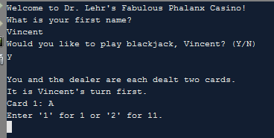
4. Gameplay and Rules
Players are greeted when starting the program and are prompted for their name. After, they are asked if they would like to play. Entering “Y” or “y” starts the game while entering “N” or “n” or any other character exits the program. If yes, the player is subsequently dealt two cards. If any ace is drawn, the player must choose 1 or 11 for its value.
Unfortunately for the time being, if an ace is dealt before the second card, you will not be able to see it until the prompt is answered. This will be fixed in Project 2.
Note: Betting, double, split, and surrender is not yet implemented. They are being saved for Project 2.

Slide 7
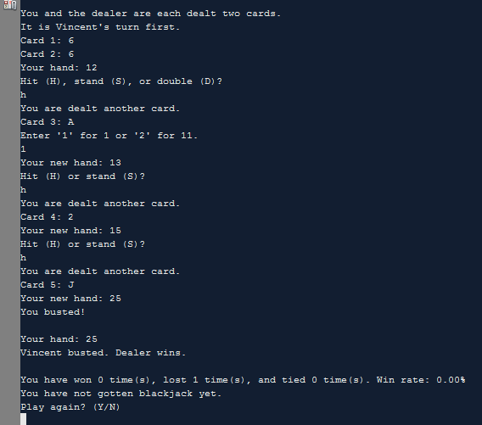
After the initial two cards are dealt, the player is prompt to hit, stand, or double.
Hit: Take an additional card. This may be done as many times as they desire.
Stand: Take no more cards, ending their turn.
Double: Double their bet and take exactly one card, ending their turn (unfinished).
If your hand total goes over 21, you bust and immediately lose, as seen in the picture.
Your wins, losses, ties, win rate, and blackjacks are displayed after each round. The player is also prompted if they would like to play again.

Slide 8
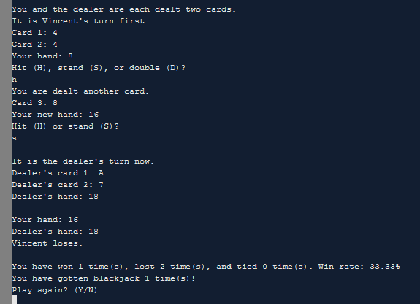
This is an example of hitting then standing at 16, but still losing because the dealer got 18.

Slide 9
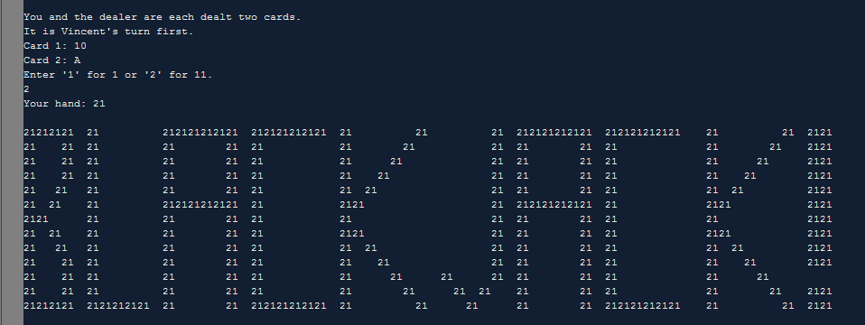
The player immediately wins if their total on the first two cards is 21 (“blackjack”), unless the dealer also has blackjack. A blackjack beats all hands that are not blackjack, even if their total is 21. Additionally, this large BLACKJACK banner made of “21” is displayed if the player has blackjack. This results in a tie.

Slide 10
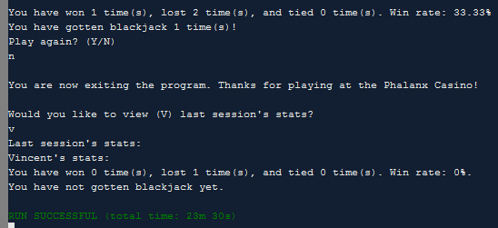
Declining to play again allows the player to view their last session’s cumulative stats. Before the program closes completely, the current session’s stats overwrites the previous stats in a .txt file named winloss.txt for future review.

Slide 11
5. Development Summary
Total lines of source file: 680
I used NetBeans IDE. Design and coding took approximately 23 hours.

Slide 12
5.1 Version 1 Comments on Development
This was a barebones version of my game. Features include hitting and standing functionality, checking for blackjack, basic dealer logic for hitting and standing, and determining the winner.
Total lines: 188

Slide 13
5.2 Version 2 Comments on Development
Version 2 attempted to introduce a betting system, but this was quickly abandoned once I realized the logic was not quite right yet. A switch case was added to the beginning with input verification. The BLACKJACK banner was also added to make the game more exciting. I also decided to grab the user’s name to make it a bit more personalized.
Total lines: 210

Slide 14
5.3 Version Comments on Development
The issue of getting 22 when starting the game was fixed by checking for double aces and allowing the player to pick between 12 or 2. Aces were also checked when hitting. The issue of busting and not immediately losing was fixed as well by using Booleans. Dealer’s logic was further expanded to account for aces. Booleans were also used for the win conditions for blackjack. Lastly, a counter for wins, losses, ties, and blackjacks were included at the conclusion of every round.
Total lines: 334

Slide 15
5.4 Version Comments on Development
Roughly 8 to 9 hours were dedicated to this version and the game’s logic was vastly improved. I implemented ace checking for both initial cards by separating them into two variables. I also had the game randomly output 10, J, Q, or K when encountering 10s. I fixed quite a bit of the minor formatting issues my game was having also. Card numbering was added to see how many were dealt to you and the dealer. The ability to view last session’s stats were added. Lastly, ending the game also saves the player’s stats into a .txt file for future review.
Total lines: 680

